Slide 1


GROUP 11 - PROJECT
TEAM MEMBERS
231080037 Garima Verma
220479 Jayant Vikash Jha
231080069 Rohit Kumar
200988 Smriti Tripathi
IPL MANIA

Slide 2



INTRODUCTION
IPL MANIA IS AN R-SHINY APP, WHEREIN YOU’LL BE ABLE TO FIND INTERESTING INSIGHTS ABOUT YOUR FAVOURITE IPL PLAYERS AND TEAMS. YOU’LL ALSO BE ABLE TO BUILD TEAMS VIA. AUCTIONING AND SEE IF YOUR CRICKET STRATEGIES MAKE YOU SUCCEED OR NOT !
THROUGH THIS APP –
DEEPLY ANALYSE THE IPL STATISTICS (2013-2023)
USER CAN COMPETE WITH HIS/HER FRIENDS BY MAKING THEIR OWN TEAM AND TAKING PART IN AN IPL MATCH.
USER WILL BE ABLE TO LOCATE THE COUNTRIES OF HIS/HER FAVOURITE PLAYERS.
Let’s look at the structures of these datasets :

Slide 3
BATSMEN
CATEGORICAL VARIABLES
NUMERICAL VARIABLES
Player Names
Player Teams
Rank of Player
Matches Played
Innings
Number of Not Outs
Total Runs
Highest Score
Average Runs
Number of Balls Faced
Strike Rate
100s
50s
0s
4s
6s

Slide 4
BOWLERS
CATEGORICAL VARIABLES
NUMERICAL VARIABLES
Player Name
Player Team
Rank of Player
Matches Played
Innings
Balls thrown
Overs bowled
Maidens Earned
Runs Given to Batsmen
Wickets Taken
Best Bowling Innings
Average
Economy Rate
Strike Rate
4s
5s

Slide 5
POINTS - TABLE
CATEGORICAL VARIABLES
NUMERICAL VARIABLES
Team Name
Matches Played
Matches Won
Matches Lost
Matches Tied
Numbers of Matches Abandoned
Total Points
Net Run Rate

Slide 6
DATA VISUALISATION

Slide 7
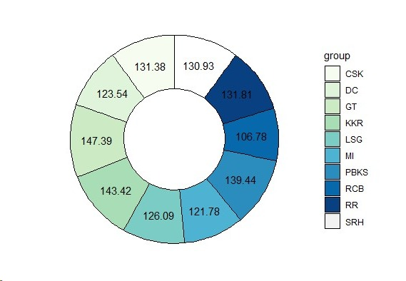
AVERAGE STRIKE RATE PER TEAM
Punjab Kings have the Highest Average Strike Rate.
Royal Challengers Bangalore have the Lowest Average Strike Rate.

Slide 8
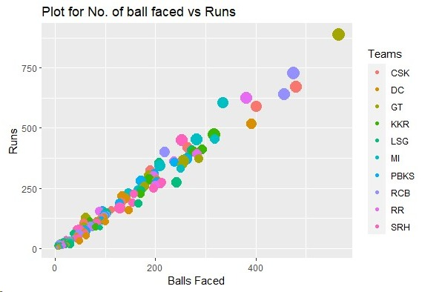
NUMBER OF BALLS VS RUNS
We can see that from this Graph Number of Balls is STRONGLY correlated with Runs.
Higher the balls faced – Higher the runs.

Slide 9
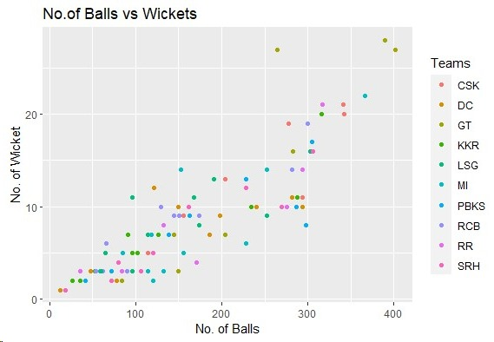
NUMBER OF BALLS VS WICKETS
The correlation between number of wickets and number of balls is significant.

Slide 10
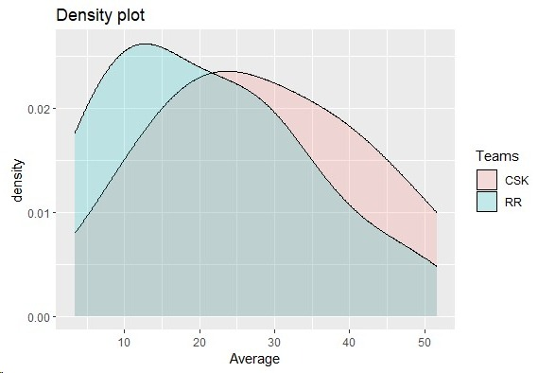
DENSITY VS AVERAGE
As probability of players of RR between 10-15 runs is Maximum where as it is 20-25 for CSK hence we can say CSK has more chances of scoring good and performing better.

Slide 11
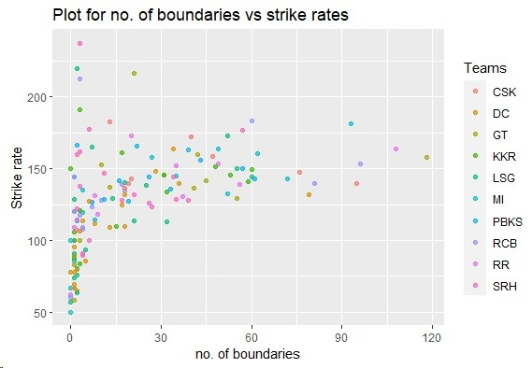
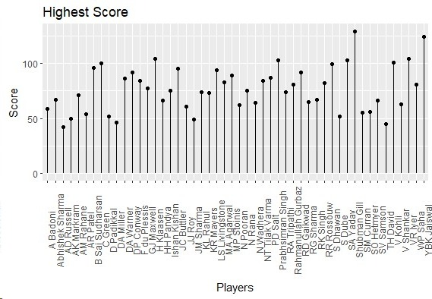
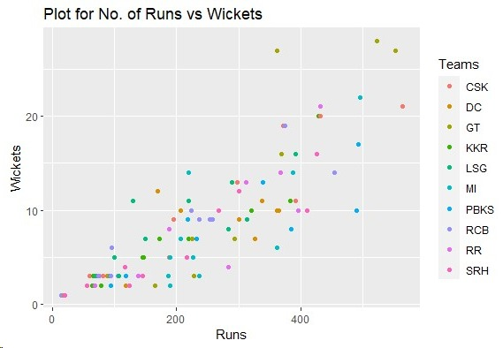
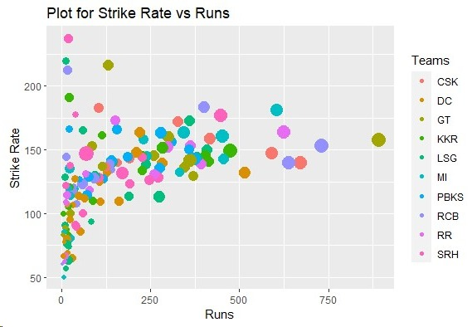
NUMBER OF BOUNDARIES VS STRIKE RATES
PLAYERS VS HIGHEST SCORE
NUMBER OF RUNS VS WICKETS
STRIKE RATE VS NUMBER OF RUNS

Slide 12
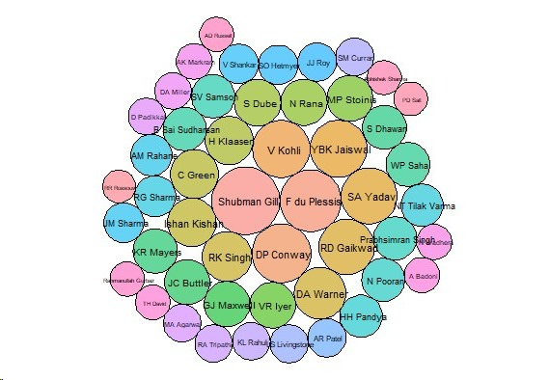
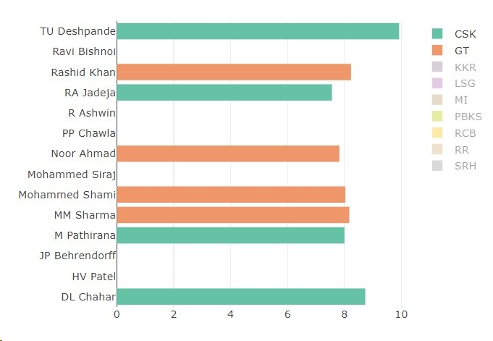
BUBBLE CHART SHOWING THE MOST IMPACTFUL BATSMEN OF IPL 2023
COMPARISON BETWEEN THE ECONOMY RATES OF BOWLERS PRESENT IN THE TOP 20 IN 2023 OF CSK AND GT

Slide 13
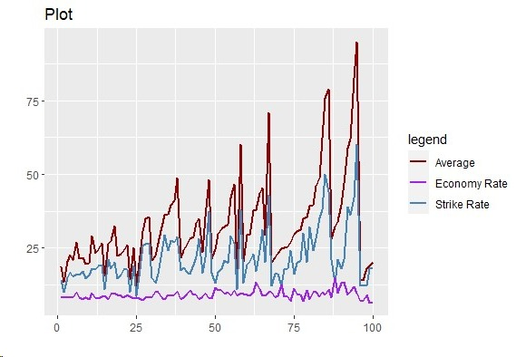
COMPARISON BETWEEN THE AVERAGE, ECONOMY RATE, AND STRIKE RATE OF BOWLERS
The economy rate of all the bowlers in 2023 is somewhat constant.

Slide 14
VALUABLE INSIGHTS
There is a STRONG correlation between TOTAL NUMBER OF BALLS FACED vs TOTAL RUNS.
There is some correlation between NUMBER OF BALLS BOWLED BY A BOWLER vs WICKETS TAKEN.
If a team has a large amount of Players who have a GOOD AVERAGE then that team has a HIGHER PROBABILITY of PERFORMING GOOD.
Players with MORE NUMBER OF BOUNDARIES tend to have BETTER STRIKE RATE if they have faced SIGNIFICANT AMOUNT OF BALLS.
The LOWER the ECONOMY RATE of the BOWLERS in the team, the BETTER is their TEAM’S PERFORMANCE.
Even when we rank the players according to the WICKETS TAKEN, still we see that with the increase in RANK, the STRIKE RATE, and AVERAGE also INCREASES. So, there appears to be a relation between these three.

Slide 15
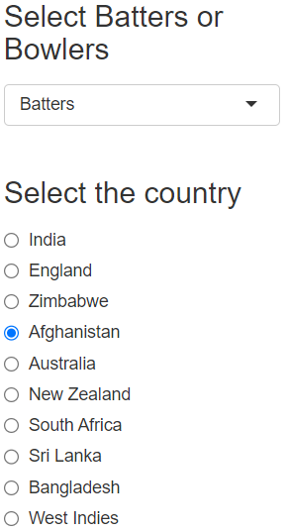

MAP
This map will help you find the nationality of your favourite BATSMEN and BOWLERS who played in IPL 2023.
In total their were 10 countries –
INDIA
ENGLAND
ZIMBABWE
AFGHANISTAN
AUSTRALIA
NEW ZEALAND
SOUTH AFRICA
SRI LANKA
BANGLADESH
WEST INDIES

Slide 16
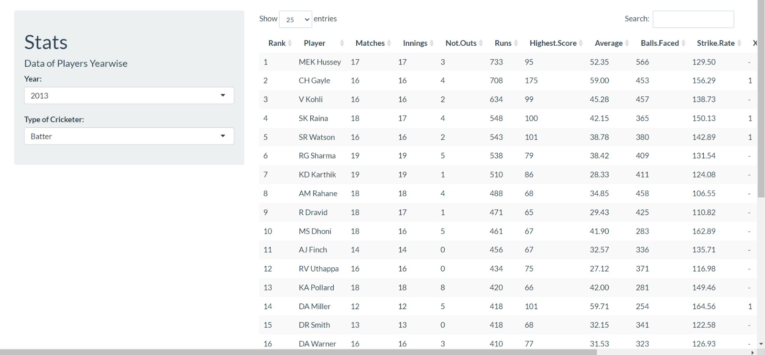
SUMMARY TAB

Slide 17
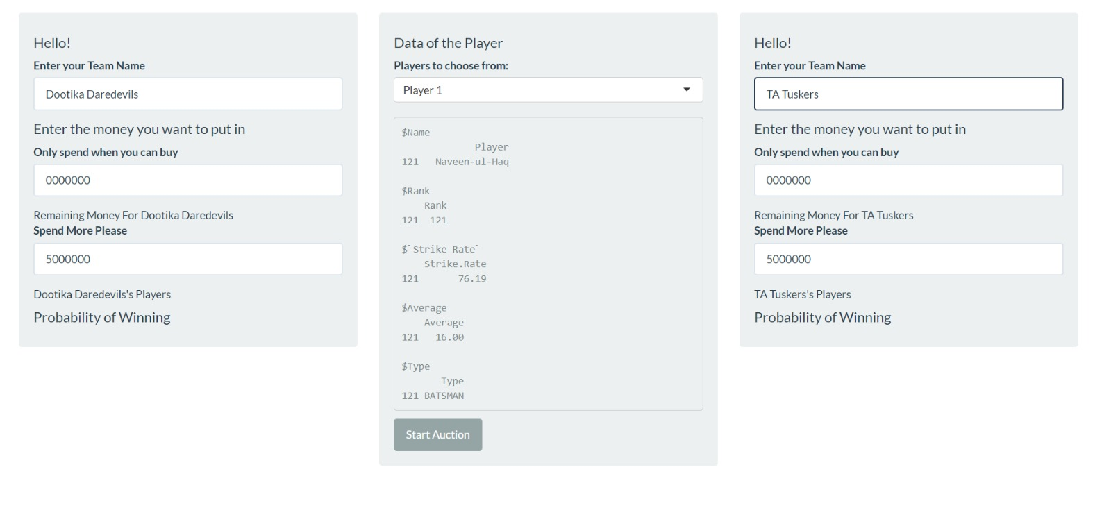
AUCTION TAB

Slide 18
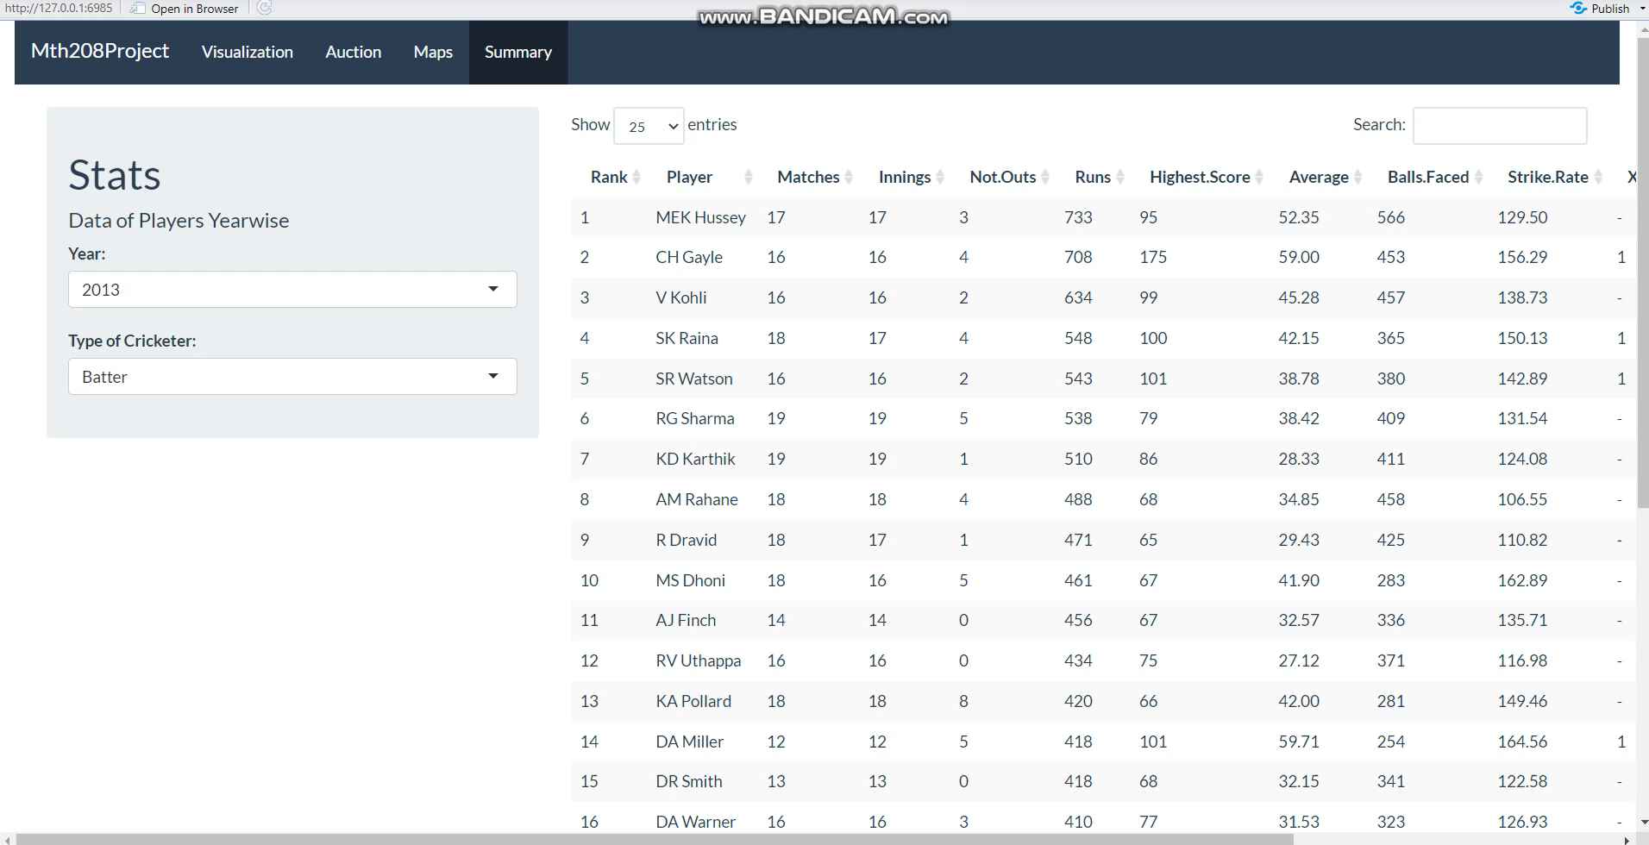
VIDEO OF APP

Slide 19
DATA SOURCE
We have taken the dataset of Batsmen, Bowlers, and Points-Table from the website - https://www.espncricinfo.com

Slide 20
THANK YOU

